Slide 1
Big Data
KC4000

Slide 2
What is big data?
Umbrella term
Data sets that traditional tools cannot handle
Large volumes of data
Varying in nature (variety)
Rapidly changing data (velocity)
Fundamentally different to traditional database systems
Examples of ‘big data’
Stock markets (NY stock exchange generates 1TB data a day)
Social Media (Facebook generates 500+ TB a day … mainly cat pictures)
Aeronautical (a jet engine generates 10+TB of data for each 30 min flight which leads to industry generating Petabytes of data each day)
Data is varied
Structured (traditional data)
Unstructured (Google Search)
Semi-Structured (Xml data)
Big data makes database geeks twitch … and not necessarily in a good way!

Slide 3

Data Types - Structured
Previous weeks have looked at the nature of data and its organisational use
Traditional data is structured, fixed in nature
Relational model is constrained
Not all data may be present but structure remains constant.
Emp_Firstname | Emp_Surname | Emp_DoB | Emp_ID | Emp_grade
CLOUD | STRIFE | 26/08/1972 | 1 | 9
NYX | ULRIC | 23/09/1963 | 2 | 8
LUCHE | LAZARUS | 26/01/1973 | 3 | 5
CID | HIGHWIND | 05/1/1974 | 4 | 5
CID | PREVIA |  | 5 | 5

Slide 4
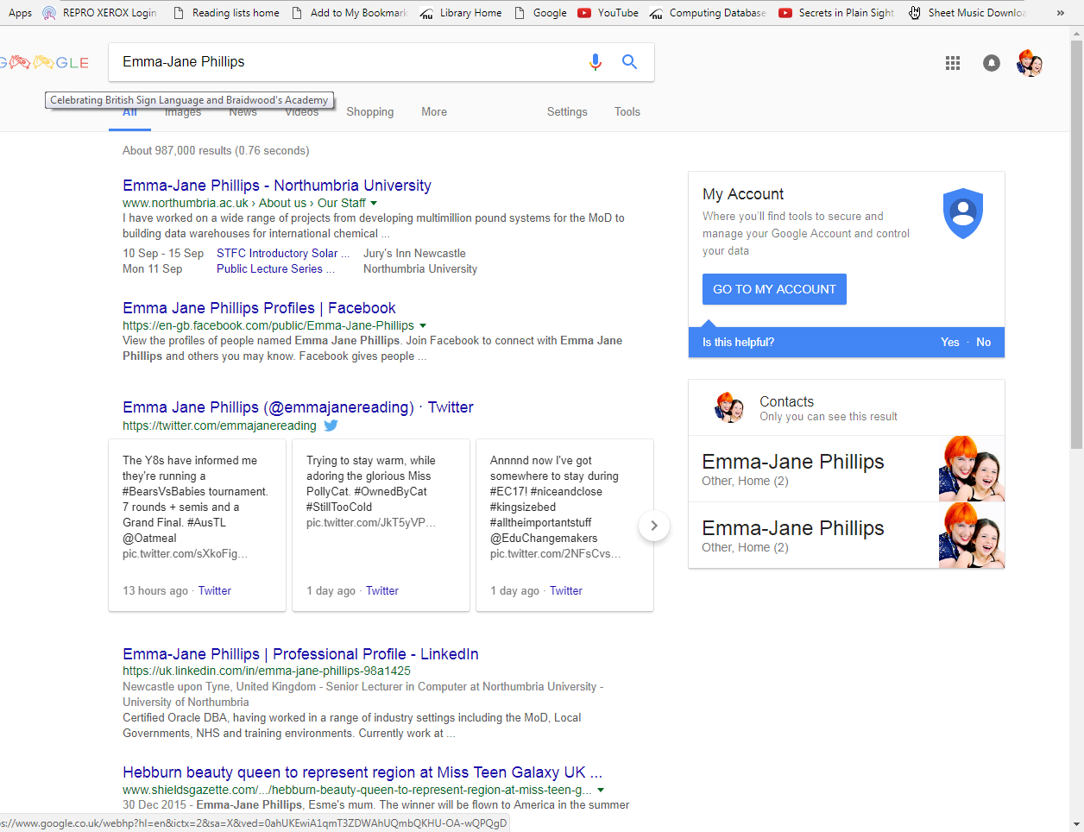
Unstructured
More data accessed is not traditional/structured but more dynamic/unstructured
The structure and format of the data is not consistent or predetermined.
Traditionally this type of data cannot be held in a relational database as that requires a consistent structure.

Slide 5
Challenges of Big Data
Big data is data sets so large and complex that they cannot be processed easily by DBMS tools or traditional data processing applications
This leads to issues in a number of areas
Data capture
Storage of data
Searching
Analysis
Visualisation
Validity
Big data arises due to the additional data now available from analysis of a large data set
Business trends
Quality of research (related citations etc)
Crime identification
Real-time monitoring (road traffic, weather disasters etc.)

Slide 6
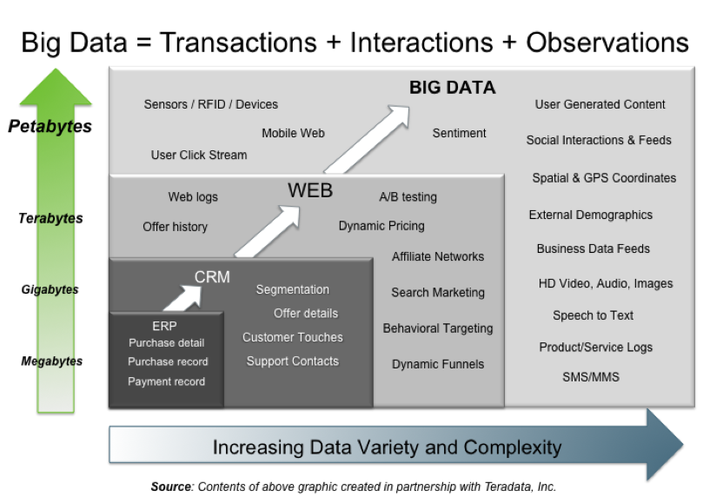
The 3 V’s
Key element of big data theory
Volume
Velocity
Variety

Slide 7
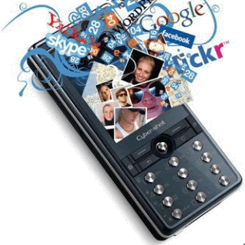
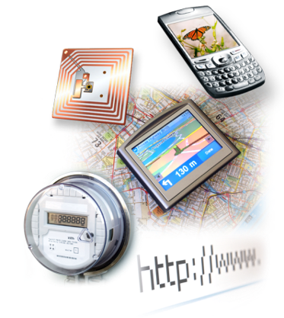

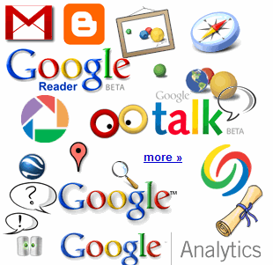

Where is the data?
4.6 billion camera phones world wide
30 billion RFID tags today (1.3B in 2005)
12+ TBs of tweet data every day
100s of millions of GPS enabled devices sold annually
? TBs of data every day
25+ TBs of log data every day
2+ billion people on the Web by end 2011
76 million smart meters in 2009… 200M by 2014

Slide 8
How is big data used
Big data is also increasingly used to optimise business processes.
Retailers are able to optimise their stock based on predictions generated from social media data, web search trends and weather forecasts
HR business processes are also being improved using big data analytics
The NFL has developed its own platform of applications to assist all 32 teams in making the best decisions based on everything from the condition of the grass on the field, to the weather, to statistics about an individual player's performance while in university. It is all in the name of strategy as well as reducing player injuries.
The U.S. uses big data analytics to foil terrorist plots
Big data techniques can detect and prevent cyber attacks.
Police forces use big data tools to catch criminals and even predict criminal activity
Credit card companies use big data use it to detect fraudulent transactions

Slide 9
Industry example
Fraud detection
Insurance companies have major problems with fraudulent claims
Cost to detect v cost to pay out (why whiplash claims are unchallenged)
Need big data to determine fraud more effectively (include additional technology such as neural networks)
COMPANY A COMPANY B COMPANY C
Existing system would not be able to check for this type of interdependent claim
Claiming injury yet partying on FB/Twitter/Instram etc
Claimant A
Claimant B
Claimant C
Witness A
Witness B
Witness C
Injured B
Injured C

Slide 10
Google Flu
Web service from Google that estimated flu activity in 25 countries launched in 2008
Utilised google search queries to predict flu activity
Compared findings to a historic baseline level for its corresponding region and then reports the activity level as either minimal, low, moderate, high, or intense
Queries were anonymised to protect privacy
The initial Google paper stated that the Google Flu Trends predictions were 97% accurate comparing with CDC data
Accuracy levels fell dramatically 2011-2013
Exam question!!!!!

Slide 11
Seminar
This week the seminar is directed at the topic of google flue which is also the essay question on the first exam paper.
Read the papers that are under the assessment section of elp

